Slide 1

Department of Computer Science
COMSATS Institute of IT, Abbottabad
Members | Registration Number
Zeeshan Zafar | FA14-BSE-011
Yousaf Munir | FA14-BSE-035
Hafiz Muhammad Huzaifa Noor | SP14-BSE-032
Supervisor
Sir Ashfaq Ahmed

Slide 2
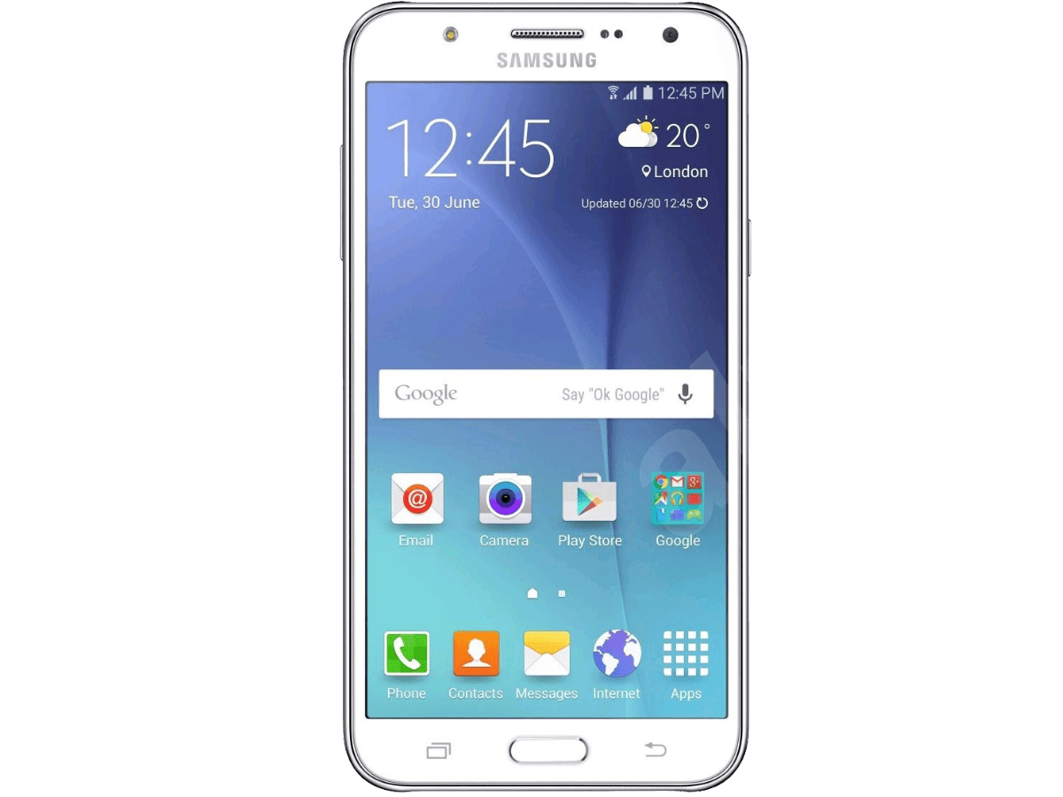
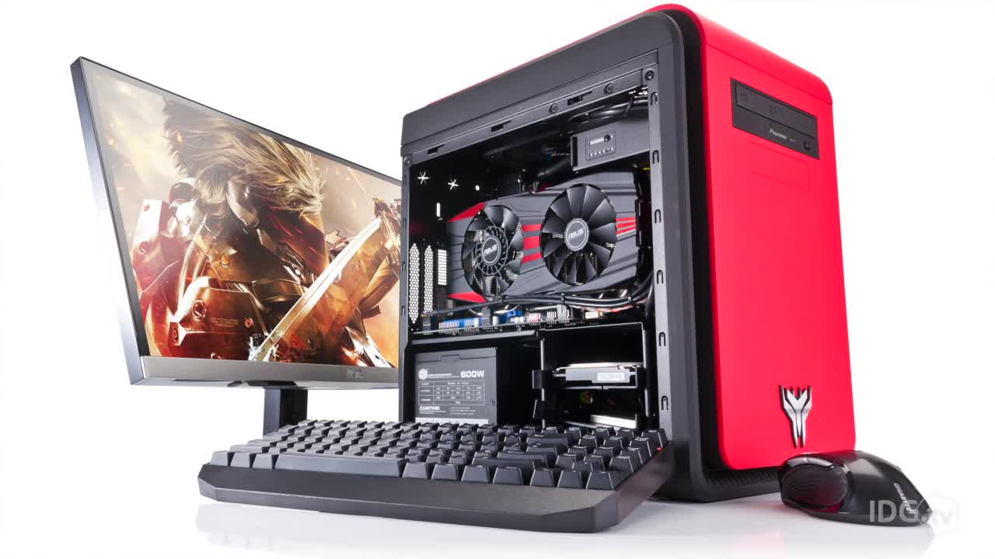
Deliver My Grocery
Android, Desktop

Slide 3
Agenda of the Presentation
Motivation
Brief Introduction
Scope
Functionalities
Tool/Platforms
Feasibility
Schedule
Conclusion

Slide 4
Motivation
Time is Money
As the world grows, the importance of time grow, and due to lack of time people cannot buy grocery for their house, so this app will help such people to buy grocery without wasting their time.
Unhealthy Person
This app will help unhealthy people to get their grocery at their door step.
Employment
Provide an option for unemployed person to get job.

Slide 5
Brief Introduction
Android and Desktop based application
Customer will submit their products, which will be send to the central and then central will allocate the nearest grocery agent and also send the product list to the nearest store to make the item ready for the agent. The agent will go to the specific store and pick the products.

Slide 6
Scope
Customer can login.
Customer can place grocery order.
Customer can see agent location on QGIS.
Delivery Agent will be able to send the image of the grocery to the related customer.
The agent will be able to see the location of the customer and Store on GIS map.
The store agent will be able to see the product list of the new order.

Slide 7
Functionalities
Admin Module
The admin will be able to add, delete, update the product list for the grocery.
Admin will be able to monitor all the transaction between customers and delivery agents.
Admin will be able to point new store on GIS map.

Slide 8
Functionalities
Store Module
The store agent will be able to see the product list of the new order.
The store agent will be able to view the delivery agent on GIS map.

Slide 9
Functionalities
Delivery Agent Module
Agent will be able to send the image of the grocery to the related customer.
The agent will be able to see the location of the customer on GIS map.
The agent will be able to see the store location on GIS map.

Slide 10
Functionalities
Customer Module
Customer will able to select the categories for the grocery.
Customer will be able to search for the grocery.
Customer will be able to select the quantity and weight of the grocery items.
Customer will have an emergency delivery option.

Slide 11





Proposed Tools/Platforms
Android Studio
Eclipse
Linux
Smart phone
QGIS
MySQL

Slide 12
Feasibility
Technical
Android Studio- to build all android base modules.
SQLite- the database for android application.
MySQL- the database for desktop application.
QGIS- for android and desktop base GIS.
http://www.qgis.org/en/site/forusers/download.html
Eclipse- to build desktop base module.

Slide 13
Feasibility
Technical
Medium Specs Laptop or PC with minimum 8GB RAM.
Linux OS, better runs Android Studio.
Smartphone, with minimum Android 6.

Slide 14
Feasibility
Financial
Resource Name [hardware or software] | Price [Monetary cost] | Source [website URL/Dealer's address etc.]
Android Studio | $ 0 (Free) | https://developer.android.com/studio/index.html
MySQL | $ 0 (Free) | https://www.mysql.com/downloads/
Eclipse | $ 0 (Free) | https://www.eclipse.org/downloads/?
Smartphone | $ 0 (Free) | Locally Available
Medium Specs PC or Laptop | $ 400.00 | Locally Available
QGIS | $ 0 (Free) | http://www.qgis.org/en/site/forusers/download.html
Sponsors/ Funding sources | Self.

Slide 15
Feasibility
Resource feasibility
Resource Name [hardware or software] |  |  | Source [website URL/Dealer's address etc.]
Android Studio |  |  | https://developer.android.com/studio/index.html
MySQL |  |  | https://www.mysql.com/downloads/
Eclipse |  |  | https://www.eclipse.org/downloads/?
Smartphone |  |  | Locally Available
Medium Specs PC or Laptop |  |  | Locally Available
QGIS |  |  | http://www.qgis.org/en/site/forusers/download.html

Slide 16
Feasibility
Operational feasibility
The project contains android emulation and real world implementation of android modules.

Slide 17
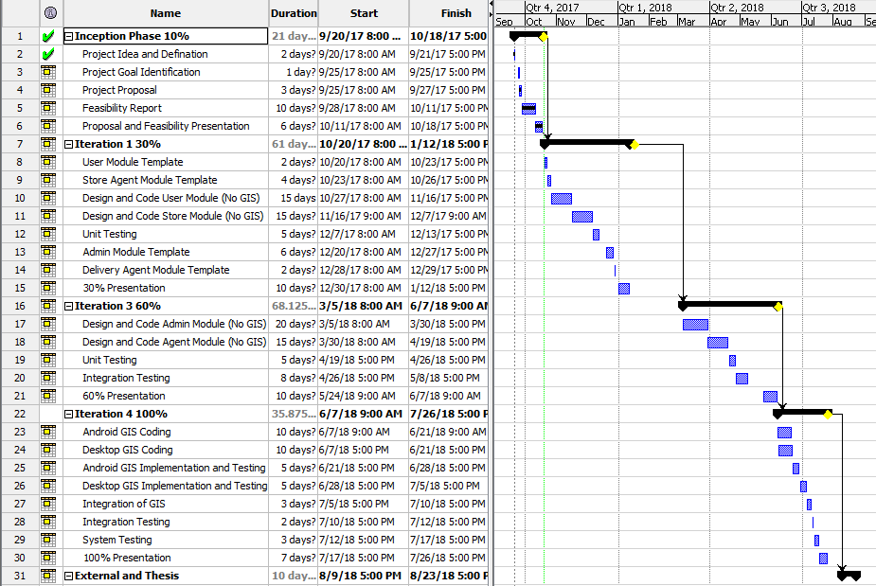
Schedule

Slide 18
Tasks for 1st Iteration (or 30%)
Database creation with ERD, Class Diagram.
User Module Interfaces with database connectivity and Design Documents.

Slide 19
Conclusion
Conclusion:
The technologies we will use are free or open source.
Its an android base application which save the time of people.
GIS will help user to view the location of agent.
The user can get grocery in 30 minutes.

Slide 20
☺ Thankyou ☺

